Slide 1
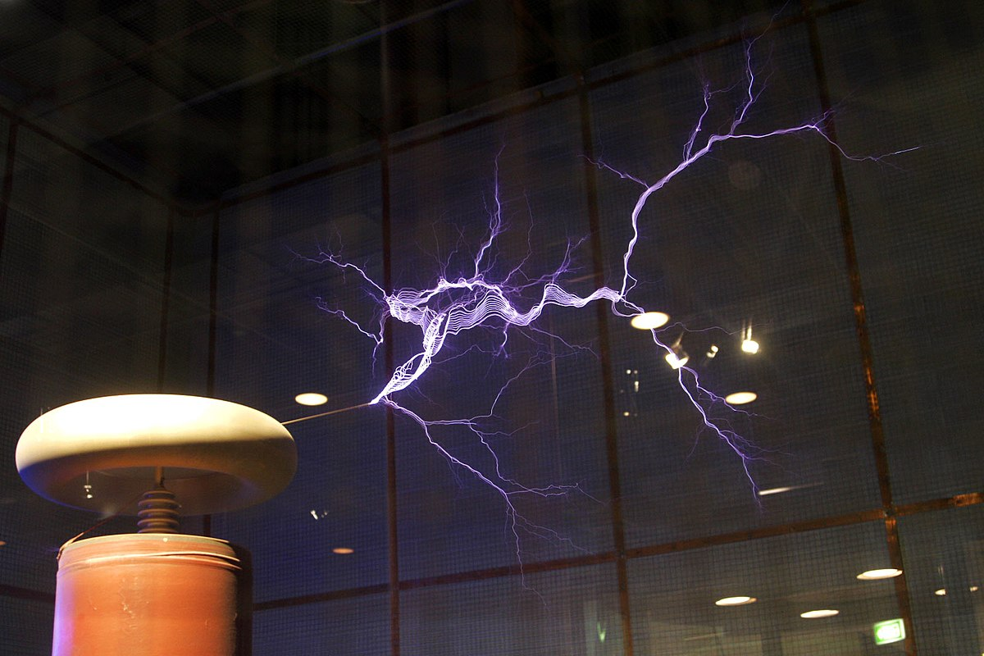
Musical Tesla Coils
Maximillian Domenech
Leonard Corelli
Dennis Krivda

Slide 2
Introduction
Tesla coil produces enormously high voltages at the surface of its toroid, which ionizes the air around it
Allows for a flow of charge which we see as a spark
Modulates the air at a certain frequency which we hear as sound
The square wave input frequency determines the frequency of the sound produced by Tesla coil

Slide 3
Problem Description
Build will require the integration of electronics, power electronics, PCB design, control systems, embedded systems, and electromagnetic physics
Completed project can be used as a live demonstration of electrical engineering

Slide 4
Proposed Solution
Build two Tesla coils from “scratch”
PVC pipe, wood, aluminum ducting, wire, varnish, etc.
Deconstruct wall mains voltage (120 V_{AC} rms) and reconstruct as square wave with amplitude of 170 V
The input to our primary coil
Control the note played by controlling the frequency of this square wave

Slide 5
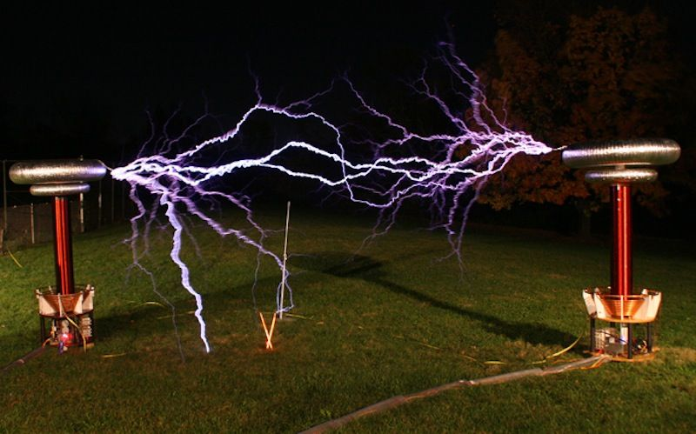
Demonstrated Features
Play numerous (ideally 5) songs on the Tesla coils
Coils will be portable

Slide 6
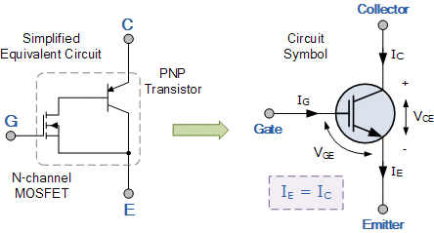
Available Technologies
PCB & microcontroller
Tesla coil and materials
Electronic components
HV capacitors, op-amps, inductors, resistors, IGBTs, diodes, potentiometers

Slide 7
Engineering Content
Five main components of the project
Full bridge rectifier
Half bridge inverter
Interrupter
Tesla coils
Programming microcontroller
Safety and security
While Tesla coil produces immensely high voltage, it is also a low current device
Fuses, flyback diodes

Slide 8
Conclusion
Project will be challenging, but achievable
While we certainly have things to learn, the internet will prove to be a valuable resource
Our project is very much a physical build
From the circuit design, printing, and soldering, to the extensive oscilloscope testing and tweaking, to the building of the Tesla coils
Requires software as well for the control logic
Connects electrical engineering (both hardware and software) with something we all know and love: music!
A working musical Tesla coil system will make for an incredible demonstration
https://www.youtube.com/watch?v=fLiji1YgDGU

