Slide 1
EEG Alarm
Jackson Bautch, Alex Beck, Josh O’Brien, Megan O’Donnell

Slide 2
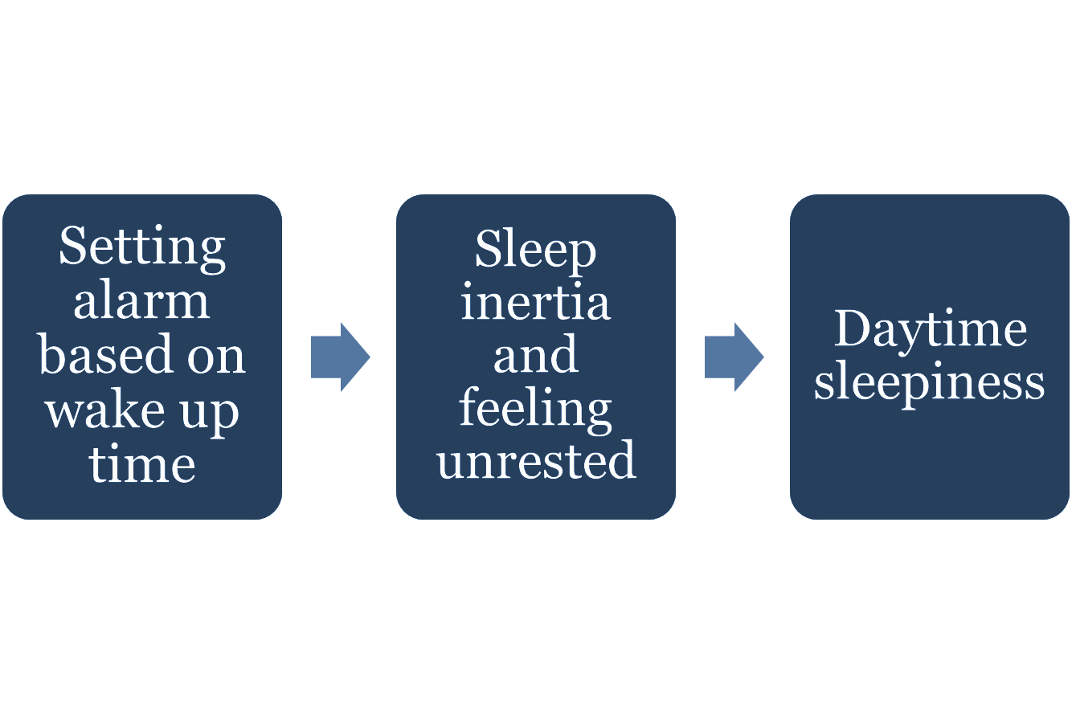
Identified Problem

Slide 3
Proposed Solution
Track sleep stages throughout the night
Electroencephalogram (EEG)
Fewer electrodes, limit device size
Send sleep data to user’s phone
Phone and EEG record sleep stages to set off alarm in lightest sleep

Slide 4
Intended Demonstrated Features
EEG and ECG Sensitivity -measure electrical activity from the heart + brain
Wireless communication - sensors and microcontroller communicate with app/website through WIFI
Health Metrics - display information to the user in both live-feed and ‘night’s sleep’ summary form. Heart Rate, time asleep etc.
Easy Fit - package sensors and controller in comfortable, lightweight manor to allow for seamless integration into comfortable sleeping.
Alarm Feature - allow user to set desired wake up range and wake up the user during the correct sleep cycle stage.

Slide 5
Available Technologies
EEG technology has existed since the 1920s
Integrated circuits for biopotential data acquisition, amplification, filtering
ESP32 bluetooth capabilities for sending data

Slide 6
Engineering Content
EEG Sensing
Heart Rate Sensing
IoT and Wireless System

Slide 7
Closing Thoughts
Benefits
Still waking up on time, but feeling better rested
Easier time waking up
Recorded sleep data (heart rate, sleep stages)
Comfortable to wear

