Slide 1

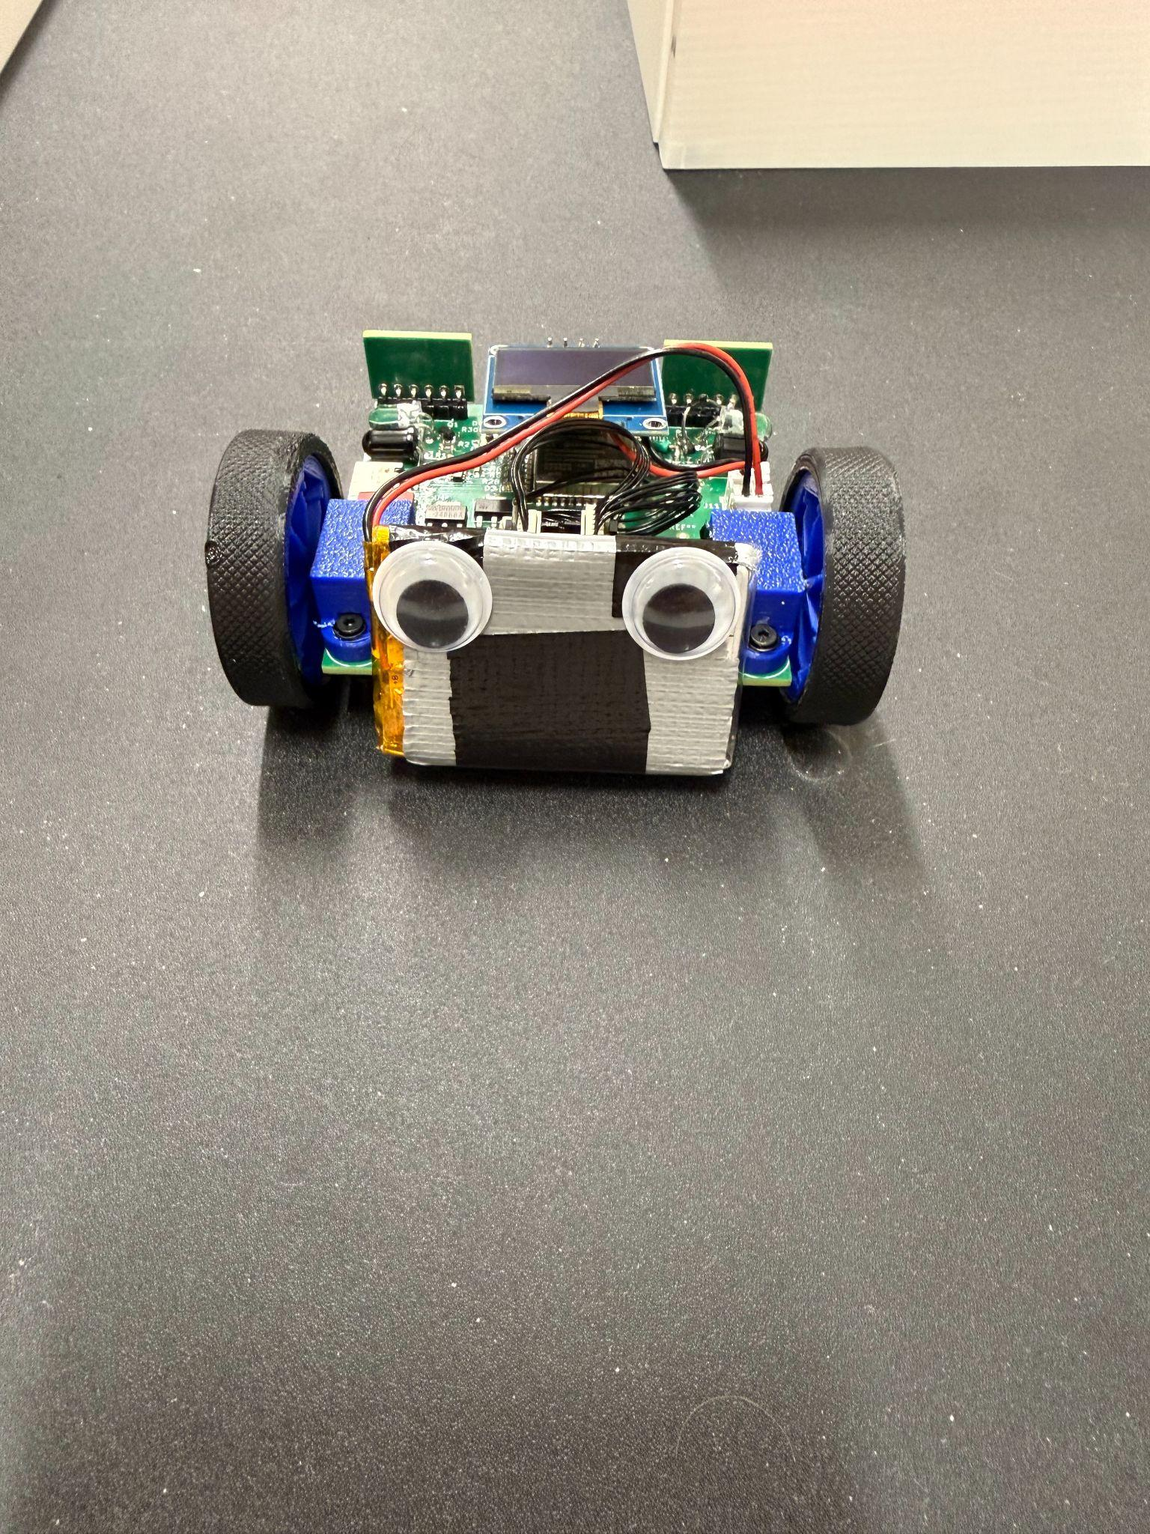
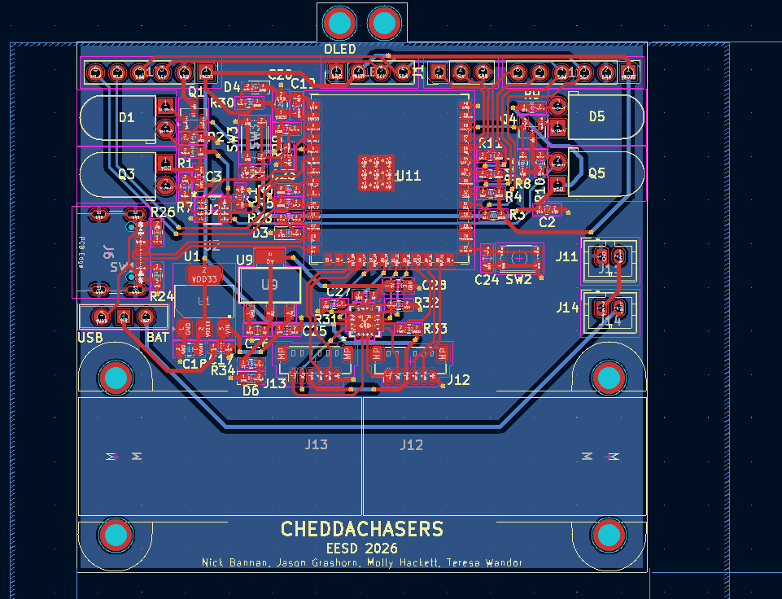
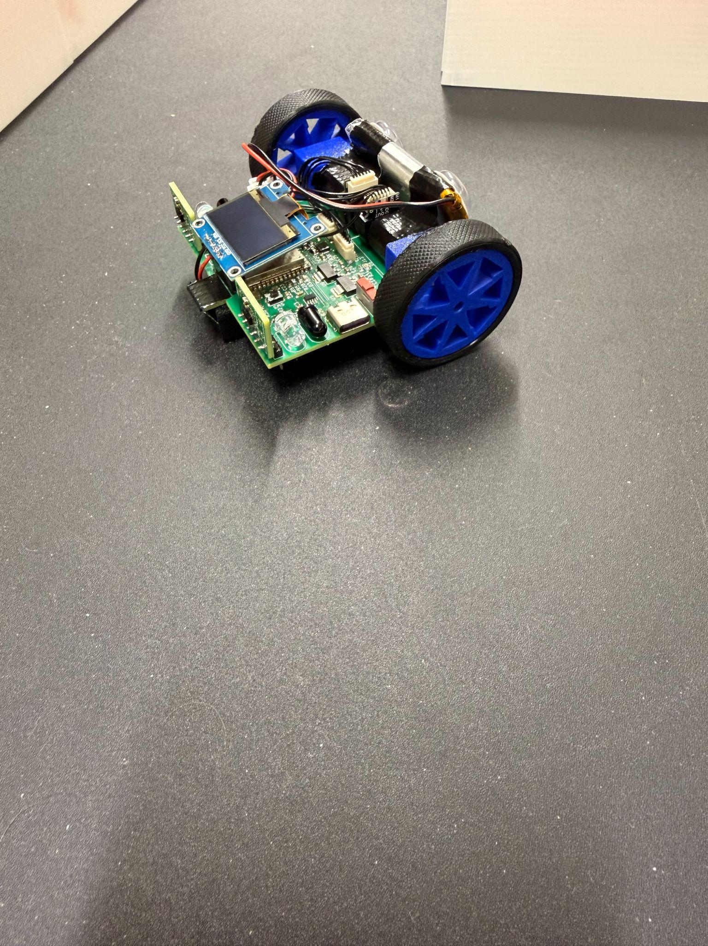
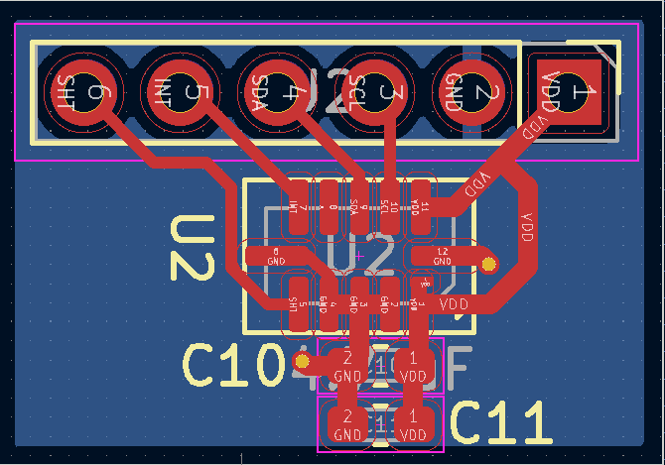
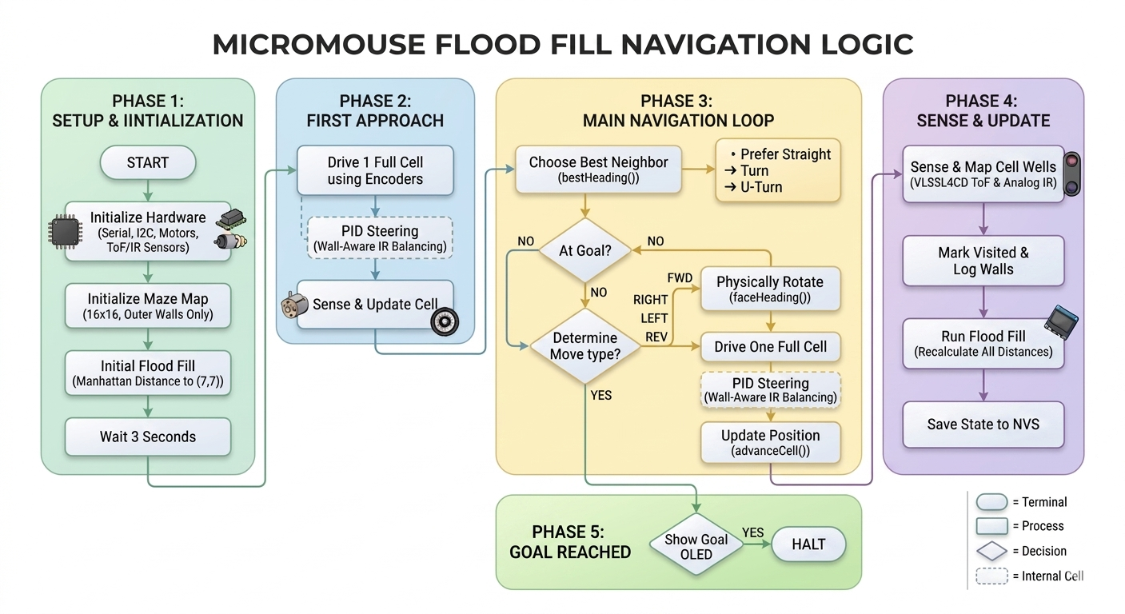
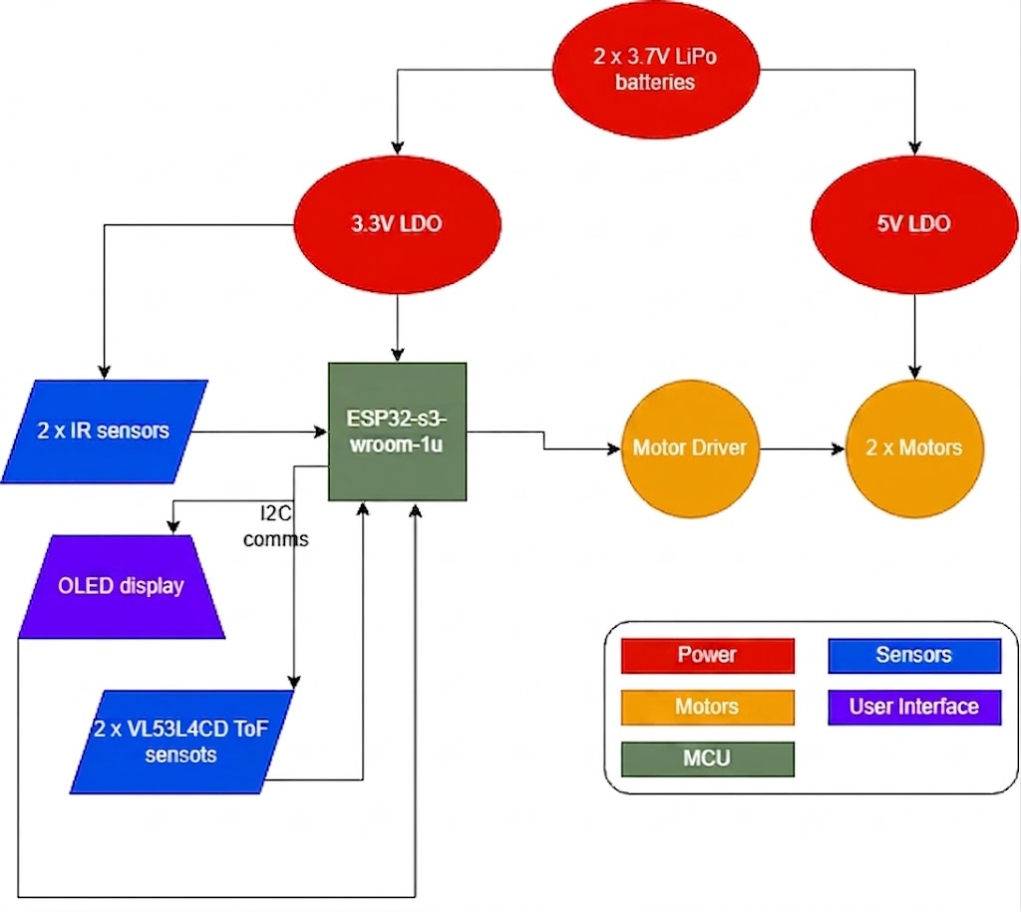
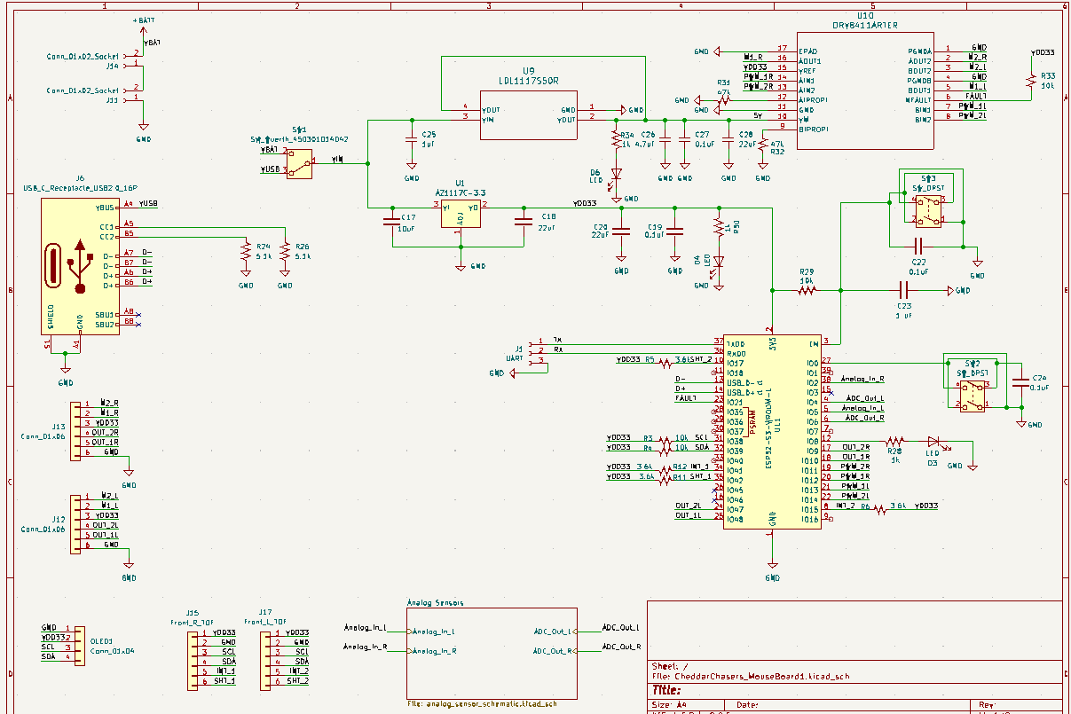
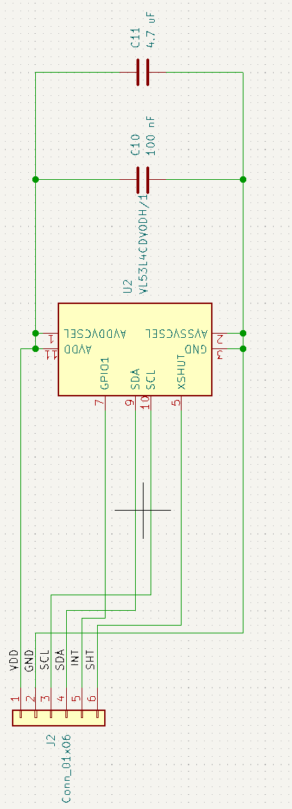
Cheddar Chasers
Molly Hackett, Teresa Wandor, Nick Bannan, Jason Grashorn
Department of Electrical Engineering University of Notre Dame, Notre Dame, IN 46556 Notre Dame Electrical Engineering Senior Design
Introduction
Physical Design
Board Design
Design Choices
Problem:
Design an autonomous robot to navigate a 16x16 maze with 180mm square cells from a corner to the center
The robot is required to:
Map the unknown environment
Solve for the shortest path
Execute speed runs within a 10-minute time limit.
Solution:
Design a PCB that allows the robot to take in adequate information to solve the maze in a short amount of time
Integration of MCU, sensors, and motors
Microcontroller:
Chose ESP32-S3-WROOM-1U with no antenna to save footprint space
Analog Sensor Considerations:
- IR sensors are proven to work with limited sensing range
- Found IR sensors have very fast update frequency (KHz)
- Reliable and fast ranging led us to use them on the sides as the primary center mechanism
ToF Sensor Considerations:
- ToF max sensing frequency is about 100Hz
- Minimal blindspot, range over one meter, high precision, and high accuracy
- Chose VL53L4CD with 0 to 1300 mm range, and a max error of ±7 mm
- Error of ± 3 mm in our testing
Motor Considerations:
- Tested gear ratios from 25:1 to 200:1
- Found 50:1 had adequate speed and low enough starting PWM to give us sufficient speed resolution
Code Flow
Subsystems
Schematics
Microcontroller:
ESP32-S3-WROOM-1U-N8
Power:
- 2 x 3.7V LiPo batteries
- 5V linear regulator for the motors
- 3.3V linear regulator for the MCU/logic level
Sensors:
- 2 x Analog IR side sensors for side sensing
- 2 x VL53L4CD time of flight sensors for front wall sensing
- ToF are more accurate than IR with higher range
Motor:
- 2 x brushed motors with encoders
- Motor driver enables 8-bit speed resolution forward/backwards driving
User Interface:
- Monochrome 0.96" 128x64 OLED Graphic Display allowed display of location during runs

